Slide 1
Introduction to Peer Support
- Building a Peer Movement
Session 3 – Skills for Peer Support
Notes:
Slide 1 – Introduction to Peer Support
Slide description:
Introduction to Peer Support - Building a Peer Movement. Session 3 – Skills for Peer Support
Time:
Until you start.
Why:
This is simply a placeholder, something to have up as people arrive.

Slide 2
Acknowledgement of Country
Aboriginal and Torres Strait Islander Peoples
Notes:
Slide 2 - Acknowledgement of Country
Slide description: Acknowledgement of Country
(Image description: A Map of Australia and a more detailed Map of the Torres Strait)
Time:
2- 3 minutes
Purpose:
Start every session by remembering that you are meeting on Aboriginal land.
Main Points:
This is about showing respect to Aboriginal people and making sure that any Aboriginal people in the room feel welcome.
Find out whose country you are on before the session.
If there is an Aboriginal or Torres Strait Islander person in the room ask them before you start if they want to do acknowledgement of or welcome to country. If they are an Elder of the Country you are on they can do welcome to country.
Things to watch out for:
You might be on country that is owned by many different people. If you are not sure, make your acknowledgement general.

Slide 3
Housekeeping
Exits and emergencies
Bathrooms (including accessible bathrooms)
Phones
Breaks
Notes:
Slide 3 – Housekeeping
Slide description:
Housekeeping, Exits and emergencies, Bathrooms (including accessible bathrooms), Phones, Breaks
Time:
2 minutes
Why:
To make sure everyone knows about the venue, the breaks for the session and to turn their phones off.
Main Points:
Introduce yourself to the group and say where you are from.
Make sure you knows the emergency procedure and where the bathrooms are.
If you are having a break, you might let people know when, or you might say that there will be a morning tea break, a lunch break and a short break in the afternoon.

Slide 4
Our Purpose
“Be the change you want
to see in the world”
Mahatma Gandhi
Notes:
Slide 4 – Our Purpose
Slide description:
Our Purpose: “Be the change you want to see in the world” - Mahatma Gandhi
Time:
2 minutes
Why:
Motivate the group and focus the attention.
Main Points:
Let the group know that we are here today to learn about peer support.
Read out the quote.
The quote talks says that we can all create positive change in the world.
Talk about what the quote means to you.
Talk about how making positive change is what we are here to do today.
Watch out for:
Don't spend too much time on the quote. It might not work for everyone.

Slide 5
Notes:
Slide 5 – Welcome
Slide description:
Welcome.
(Image Description: the word welcome in many different languages and colours)
Time:
15-20 minutes
Why:
So that people get to know each other and feel welcome.
Main Points:
Peer support starts with getting to know one another.
Ask everyone to introduce themselves and say something about themselves.
Make sure that everyone in the room has a chance to speak. Very important.
Thank everyone for their contribution.
If you are going a bit over time, don't panic.
You can also try a simple ice-breaker, like asking people to introduce themselves and ask:
What is one thing that makes you happy?
And what is one thing you would like to get out of today?
For more ideas, read Introduction/ Welcome and Icebreakers in the Peer Facilitators Toolbox.
Things to watch out for:
Make sure everyone gets equal time to speak. Ask people to share one thing only.
The length of this exercise will depend on the size of your group.
This may be first time people are together and you will need to give time for them to get to know one another.
If you are going a bit over time, don't panic. You can simply push a bit faster through the content.

Slide 6
Pre Evaluation
Notes:
Slide 6 – Pre Evaluation
Note: only use this slide if you are evaluating this workshop.
Slide description:
Pre Evaluation.
(Image description: a hand holding a pen to fill out a form)
Time:
15 minutes
Why:
To improve the program for everyone.
Main Points:
Hand out any Pre Evaluation forms.
This evaluation form will help improve the program for everyone.
Please be honest and give us feedback.
It is not a test and it is not compulsory.
Extra Questions:
Does anyone need help filling in this form?
Things to watch out for:
Some people might feel uncomfortable filling this out or asking for help. Make sure someone is available to help.

Slide 7
What do you want to get out of today?
Notes:
Slide 7 – What do you want to get out of today?
Slide description:
What do you want to get out of today?
Time:
5 minutes
Why:
To find out people’s expectations for the day.
Main Points:
Ask the group what they want to get out of today.
Write all responses on a whiteboard / butcher’s paper.
Help people feel heard by repeating what they say.
Write Parking Lot at the top of another piece of butcher’s paper. If someone says something that you cannot cover, write it down here.
For more ideas, read about Expectations and the Parking Lot in the Peer Facilitators Toolbox.
Extra Questions:
If you walked away with one thing after today, what would that be?
Things to watch out for:
Some people might want something different. That’s okay! Make some time at the end of the day for people to talk about what they want. This is peer support in action!

Slide 8
Session 3: What skills do I need?
Listening
Reflecting and
Asking Questions
Notes:
Slide 8 – Session 3: What skills do I need?
Slide description:
Session 3: What skills do I need? Listening, reflecting and asking questions.
Time:
2-5 minutes
Why:
Provide an overview of today’s material
Main Points:
Session 3 covers the most important skills for doing peer support.
Listening
Reflecting and
Asking Questions
Extra Questions:
Any questions? It is good to check people’s understanding early on. Make sure people feel they can ask questions.
Things to watch out for:
Don’t spend too much time on this slide, it is just an introduction. There will be time to go into detail later on.

Slide 9
How we work together
We start together on time and finish on time
We take responsibility for our own learning
We support each other to learn
We hold each other to account
We are respectful of each other
We are focused on learning
We are community – we look out for each other
…….. ?
Notes:
Slide 9 – How we work together
Slide description:
How we work together: We start together on time and finish on time; We take responsibility for our own learning; We support each other to learn; We hold each other to account; We are respectful of each other; We are focused on learning; We are community – we look out for each other …….. ?
Time:
Depends on number of people, no more than 10 minutes.
Why:
To set ground rules about what to expect from each other.
Main Points:
Before showing the slide, ask the group to tell you how they want to work together today.
Write down each person’s suggestion.
If the group runs out of ideas, go through the slide.
Talk about respect and confidentiality (see Peer Facilitators Toolbox for more information).
Check that everyone agrees with the list of ground rules before moving on.
Questions you might like to ask:
Is it ok to interrupt each other? Can we talk about everything we say here to other people? What should we do when we get stuck on something?
Things to watch out for:
Allow for conversations but keep an eye on the time.

Slide 10
Skills you need for peer support
Notes:
Slide 10 – Session 3 – Skills you need
Slide description:
Session 3 - Skills you need
Time:
2 minutes
Why:
To introduce the essential skills for effective peer support.
Main Points:
This session is about how we actually do peer support
It covers listening and paying attention, asking questions and reflecting
Watch out for:
Look out for people who have been quiet and check whether they are ready to say something. This is the last session. Some people who haven’t said much, but have been wanting to, know it’s their last chance to speak and be heard.

Slide 11
Are you really listening?
Notes:
Slide 11 – Are you really listening?
Slide description:
Are you really listening? (Image description: A woman is and a man are talking with one another. The man is watching her closely and appears to be listening to her.)
Time:
10 minutes
Why:
Practice listening and paying attention.
Main Points:
In this exercise we are going to practice listening and paying attention.
Ask people to turn to the person sitting next to them. Make sure everyone has a partner.
Ask that one person really listens for 3 minutes, while the other person talks about what they have learned from the course
After 3 mins change roles.
Watch out for:
Sometimes there is a bit of confusion
Remember people’s communication needs when swapping partners.
Check out your Peer Facilitators Toolbox on ‘Communication’, as well as ‘Group work’.

Slide 12
Reflecting on listening
Discuss
What do people do when they really listen?
2. How do you feel when someone really listens?
Notes:
Slide 12 – Reflecting on listening
Slide description:
Reflecting on listening. Discuss: What do people do when they really listen? How do you feel when someone really listens?
Time:
10 minutes
Why:
Practice reflecting and develop a deeper understanding of listening.
Main Points:
When we do something and reflect on it, it is easier to do it again because we know what works.
Ask people to discuss the questions on the slide for 3 minutes and then share with each other.
You might like to write it down (or get a participant to write it down) on the whiteboard or butcher’s paper.
Watch out for:
Sometimes organising people into groups can be difficult.
The best you can do is get really good at giving instructions on what you want people to do.
For more on this see your Peer Facilitators Toolbox on ‘Group work’.

Slide 13
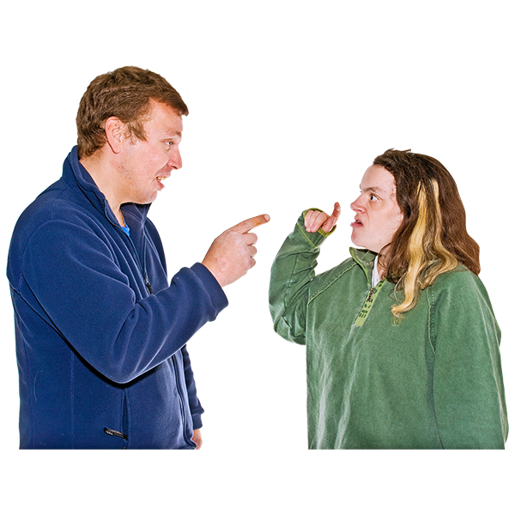
What gets in the way of really listening?
Notes:
Slide 13 - What gets in the way of listening?
Slide description:
What gets in the way of really listening?
Time: 3 minutes
Why: To identify the barriers to listening.
Main Points:
Once we know what gets in the way of listening we can try and change things.
Ask people to share some of their experiences.
You might like to write it down (or get a participant to write it down) on the whiteboard or butcher’s paper.

Slide 14
What gets in the way of really listening?
Arguing
Filling the silence
Pretending (that you are listening)
Being impatient
The chatter in your own head
Notes:
Slide 14 - What gets in the way of really listening?
Slide description:
What gets in the way of really listening? Arguing, filling the silence, pretending (that you are listening), being impatient, the chatter in your own head
Time: 2 minutes
Why: To identify the barriers to listening.
Main Points:
Talk people through the slide and give examples, maybe people have examples themselves.
Once we know what gets in the way we can try and change things.
Watch out for:
People might overcomplicate. You have a bit of time to discuss, but before you get stuck, move on.

Slide 15
The power of good questions
Notes:
Slide 15 – The power of good questions
Slide description:
The power of good questions
(Image descriptions: The first image is of colourful speech bubbles with different questions: Why? How? Where? What? Who? When?
The second image is of two hands holding up a poster saying: The power of good questions)
Time: 2 minutes
Why: To learn how good questions can help peer support.
Main Points:
Asking good questions can help you understand what the issue really is.
Good questions are important for giving and receiving peer support.

Slide 16
Closed Questions
Lead to short answers
Do not open the conversations
They are good for:
Yes / No answers
Technical or process topics
Questions requiring a single answer
Notes:
Slide 16 – Closed questions
Slide description:
Closed Questions. Lead to short answers; do not open the conversations. They are good for: Yes / no answers; Technical or process topics; Questions requiring a single answer.
Time: 2 minutes
Why: To learn about how and why to use closed questions.
Main Points:
There are situations when closed questions are great, like when you just want get an answer.
But closed questions don’t encourage other people to open up and share their story.
Have some examples ready.

Slide 17
Closed Questions often start with:
Do you..?
Did you.. ?
Was …?
When..?
Where..?
Who .. ?
Notes:
Slide 17 - Closed Questions often start with
Slide description:
Closed Questions often start with: Do you...? Did you...? Was…? When..? Where..? Who...?
Time: 2 minutes
Why: To learn about how and why to use closed questions.
Main Points:
Talk through the list on the slide
Ask people why they are all closed questions
If you have time ask people to make examples of closed questions using the list

Slide 18
Open Questions
Open up the conversation
Explore new ideas
Explore feelings and opinions
Are good for:
Finding out more
Getting closer to what’s really going on
Notes:
Slide 18 - Open Questions
Slide description:
Open Questions, open up the conversation, explore new ideas, and explore feelings and opinions. They are good for: Finding out more, getting closer to what’s really going on
Time: 3 minutes
Why: To learn about how and why to use open questions.
Main Points:
Go through the slide and have some examples ready.
There are situations when open questions are best.
In peer support situations we want to ask mostly open question to open conversations and dig a bit deeper.

Slide 19
Open Questions often start with:
Tell me..?
How.. ?
Why..?
What..?
Notes:
Slide 19 - Open Questions often start with
Slide description:
Open Questions often start with: Tell me..? How.. ? Why..? What..?
Time: 2 minutes
Why: To learn about how and why to use open questions.
Main Points:
Talk through the list on the slide
Ask people what makes the questions open questions.
If you have time get people to practice using those questions.

Slide 20
Practise good questions
Turn to the person sitting next to you and
Ask each other 2 closed questions
2. Ask each other 3 open questions
Notes:
Slide 20 – Practise good questions
Slide description:
Practise good questions. Turn to the person sitting next to you and 1. Ask each other 2 closed questions, 2. Ask each other 3 open questions.
Time: 5 minutes
Why: To practise asking open questions.
Main Points:
Ask people to turn to the person sitting next to them and ask each other 2 closed and 3 open questions.
Get people back after three minutes and then ask people to share.
Ask the group to decide together whether the questions are open or closed questions.
Open questions are harder to ask for most people.

Slide 21
Reflecting on asking questions
Which types of questions do you usually ask:
the members of your family?
your friends?
a peer?
Is there a difference in who you ask what type of questions?
Take 2 minute of silence and reflect on this.
Notes:
Slide 21 – Reflecting on asking questions
Slide description:
Reflecting on asking questions. Which types of questions do you usually ask: the members of your family? Your friends? A peer? Is there a difference in who you ask what type of questions? Take 2 minutes of silence and reflect on this.
Time: 5 minutes
Why: To practice reflecting.
Main Points:
Ask people to practice reflecting on their own about the questions on the slide.
Give people two minutes and then ask people to share.
You can practice reflecting on your own.
You can write or draw your answers if you want.
It’s good to talk to people about what you learned from your reflection.

Slide 22
Why reflect?
Notes:
Slide 22 – Why reflect?
Slide description:
Why reflect? (Image description: a hamster running inside a blue spinning wheel.)
Time: 5 minutes
Why: To understand why reflection is important to peer support.
Main Points:
Ask people to describe the image on the slide. It is of a hamster running in a spinning wheel.
Ask people why this image shows that reflection is important.
If we keep doing the same thing without thinking about it, we keep getting the same result.
Change only happens because we think about what we are doing and then decide to do something different.
This is true in peer support too! If we want to get a different outcome we have to do something differently.

Slide 23
Practice Reflecting
Act
Reflect
Learn
Notes:
Slide 23 – Practice Reflecting
Slide description:
Practice Reflecting. (Image Description: A circular flow chart with three text boxes linked by arrows. The Act text box links to the Reflect text box which links to the Learn text box which links back to the Act text box.)
Time: 5 minutes
Why: To understand more about how reflection works.
Main Points:
Reflection is thinking back about how something went and making changes next time.
Use the model of Acting, Reflecting and Learning on the slide to explain how reflection works.
Give an easy to follow example.
Reflection can be done again and again.
Everyone can change their minds and ask questions.
Watch out for:
Lots of people don't know how to do this. Also lots of people think changing your mind is a weakness.
If that comes up, get the group to talk a bit about how people learn.
Focus their experiences on how learning things and trying out different ways of doing this the situation may have gotten better.

Slide 24
Reflecting
The ability to reflect is the
No. 1 skill for making changes in your life!
Notes:
Slide 24 – Reflecting
Slide description:
Reflecting. The ability to reflect is the No. 1 skill for making changes in your life!
Time: 2 minutes
Why: The practice of reflecting.
Main Points:
Reflecting is the number 1 skill you need to make changes in your life.
Ask the group what they think about this statement.
Provide an example or ask participants to provide examples.

Slide 25
How we build a movement
Notes:
Slide 25 – How we build a movement
Slide description:
(Image Description: A man walking on a street) – video description is below
Time: 5 minutes
Why: To explore how paying it forward makes us feel good.
Main Points:
Doing good stuff, connecting with people, makes us all feel good.
Play the video. Afterwards people might want to say something. Just let it flow for a bit.
Watch out for:
You might skip this video if you are running short on time.
Video description
[This video is in Thai with English subtitles, so the video description here also includes the subtitles:
A man is walking down the street. All of a sudden there is a stream of water coming down from above, just missing him. He puts a dried up pot plant in the water stream. Next, he helps a street food trader, who is an older woman, pushing her cart up a curb. He sits on a table eating and a dog comes and he gives the dog some of his chicken. The cook watches him and shakes his head. Next, he stands in from of a mother and a child sitting on the footpath begging with a sign saying "For education" (in Thai) and he gives the girl money. A shopkeeper watching this shakes his head. Next, he hangs a bunch of bananas on the doorknob on the outside of a front door of a flat. An old woman opens the door, looks around and takes the bananas inside. A voiceover says (in Thai): "What does he get in return for doing this every day?"
Then we see him walking along the same street as in the beginning. Now the water stream is hitting the pot plant (still dried up), the old woman trader is waiting for him impatiently. She says: “There you are”, as he is running towards her. The dog still gets half of his chicken and he gives money to the girl for her education. The same man is still shaking his head.
At the end of a day in a bus, he offers his seat to a woman who is standing and afterwards we see the old woman again taking in the bananas.
Next, we see him inside his flat. He eats, feeds the chickens, prays, swats a mosquito, and waters his pot plants. A voiceover says: “He gets nothing. He won’t be richer, he won’t appear on TV”.
Again he walks the same street with the water still pouring down into the flowerpot. The voiceover says “Still anonymous”. He again helps the old trader, her cap falls off her head, she picks it up and puts it on his head as they laugh together pushing up the cart to the footpath. "And not a bit more famous," says the voiceover. He pats the dog after the meal and then the dog follows him. He pulls out his money and looks down and sees the mum, but the girl is not sitting on her usual spot on the footpath. He looks at the mum. We hear a voice calling out “Mum” the camera turns around and there is the girl in a school uniform looking at him. They look at each other. He looks at her and smiles. The voiceover says: "What he does receive are emotions". Mum looks at him.
The man who we have seen shaking his head now takes off his glasses and watches intently. We see a picture of the man and the older trader laughing together as they push the cart, him feeding the dog. The voiceover says: “He witnesses happiness”. A camera shot of a city (presumably Bangkok a queue of people). Back in this flat eating a banana; the voiceover says, “Reaches a deeper understanding" then he prays. Next the old woman is holding the bananas waving at him, him smiling a bit embarrassed and she gives him a big hug. The voiceover says: “He feels the love”. Next, the woman on the bus and then the mum is smiling up at him. The voiceover says "Receives what money can't buy". At his flat, the dog carries the watering can for him to water his plants with. He walks up the street again, this time we see the once dried up plant in the pot flowering (white Jasmine). "A world made more beautiful," says the voiceover, while we see the young girl sitting on the footpath in her school uniform teaching her mother to how to count.
Next, he is standing next to the woman trader who hands a small package of something to a customer saying: “Here’s extra”. He watches her with interest and then smiles at her. Then a close up of the flowering plant with a butterfly, first in the air, and then landing on the flower. The voiceover saying “And in your life, what do you desire most?” As the sun sets over some TV antennas and trees, he is sitting on a small stool with the dog next to him looking at his own garden. Then it ends with the logo of the Thai Life Insurance Company who made this video.]

Slide 26
What next?
Practice in your community every day
Have one peer support conversation a week
Find a Mentor
Find a Peer Support Organisation
Start your own peer support group
Do peer facilitator training
Do peer mentor training
Notes:
Slide 26 – What Next?
Slide description:
What Next? Practice in your community every day, Have one peer support conversation a week, Find a Mentor, Find a Peer Support Organisation, Start your own peer support group, Do peer facilitator training, Do peer mentor training
Time:
5 minutes
Why:
Discuss what people can do next.
Main Points:
People can start doing peer support straight away
Talk through the different ideas on the slide
People can do peer support in the community, one on one, as a group or with an organization
Find out what peer support groups and organisations are available for people
Have a date for next meeting ready if you want to meet again as a group.
Watch out for:
If you want to keep meeting as a group, make sure you have an action – something to do next.
A date and time and place for your next meeting will keep the momentum going. Don't lose it!

Slide 27
Post Evaluation
Notes:
Slide 27 – Post Evaluation
(Note: only use this slide if you are evaluating the training)
Slide description:
Post evaluation
Time:
5 minutes
Why:
To get feedback on how to improve the program.
Main Points:
Hand out the Post Evaluation form.
This evaluation form asks people what they have learned from the session.
This is not a test.
It will help to improve the program for everyone.
Please be honest and give us feedback.

Slide 28
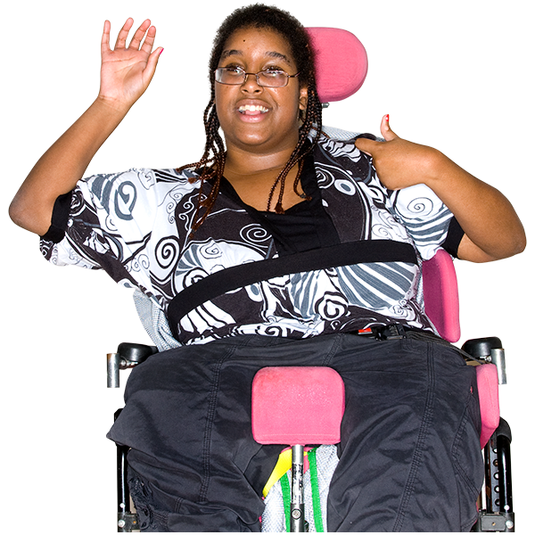
Check out
Notes:
Slide 28 – Check-out
Slide description:
Check out. (Image description: A woman using a wheelchair is waving and has her thumbs up)
Time:
5 minutes
Why:
To find out how people are feeling and their next steps.
Main Points:
A check-out helps find out how people are feeling at the end of the workshop.
It is also a very powerful way of building accountability and community.
Ask everyone to write down one word about how they are feeling at the end of the training and one next action from today’s training that they are going to take in peer support
Ask everyone to share their one word and action with the group
Make sure someone is available to write down people’s answers

Slide 29
Graduation
Notes:
Slide 29 – Graduation
Slide description:
Graduation. (Image Description: Coloured balloons floating about with loads of coloured streamers)
Time:
5 minutes
Why:
To formally close the workshop and encourage people to continue their peer support journey.
Main Points:
Celebrate achievements and closure of the program.
Announce each person, and ask them to come up and take their certificate.
Give one piece of feedback to each participant as they come up to take their certificate
Have someone to take photos.
Give information to people who need to make up sessions before they are able to graduate.

