Slide 1
Introduction to Peer Support
- Building a Peer Movement
Session 2:
Building a Peer Movement
Notes:
Slide 1 – Introduction to Peer Support
Slide description:
Introduction to Peer Support - Building a Peer Movement 1 Day Program
Time:
Until you start.
Why:
This is simply a placeholder, something to have up as people arrive.

Slide 2
Acknowledgement of Country
Aboriginal and Torres Strait Islander Peoples
Notes:
Slide 2 - Acknowledgement of Country
Slide description: Acknowledgement of Country
(Image description: A Map of Australia and a more detailed Map of the Torres Strait)
Time:
2- 3 minutes
Purpose:
Start every session by remembering that you are meeting on Aboriginal land.
Main Points:
This is about showing respect to Aboriginal people and making sure that any Aboriginal people in the room feel welcome.
Find out whose country you are on before the session.
If there is an Aboriginal or Torres Strait Islander person in the room ask them before you start if they want to do acknowledgement of or welcome to country. If they are an Elder of the Country you are on they can do welcome to country.
Things to watch out for:
You might be on country that is owned by many different people. If you are not sure, make your acknowledgement general.

Slide 3
Housekeeping
Exits and emergencies
Bathrooms (including accessible bathrooms)
Phones
Breaks
Notes:
Slide 3 – Housekeeping
Slide description:
Housekeeping, Exits and emergencies, Bathrooms (including accessible bathrooms), Phones, Breaks
Time:
2 minutes
Why:
To make sure everyone knows about the venue, the breaks for the session and to turn their phones off.
Main Points:
Introduce yourself to the group and say where you are from.
Make sure you knows the emergency procedure and where the bathrooms are.
If you are having a break, you might let people know when, or you might say that there will be a morning tea break, a lunch break and a short break in the afternoon.

Slide 4
Our Purpose
“Be the change you want
to see in the world”
Mahatma Gandhi
Notes:
Slide 4 – Our Purpose
Slide description:
Our Purpose: “Be the change you want to see in the world” - Mahatma Gandhi
Time:
2 minutes
Why:
Motivate the group and focus the attention.
Main Points:
Let the group know that we are here today to learn about peer support.
Read out the quote.
The quote talks says that we can all create positive change in the world.
Talk about what the quote means to you.
Talk about how making positive change is what we are here to do today.
Watch out for:
Don't spend too much time on the quote. It might not work for everyone.

Slide 5
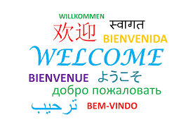
Notes:
Slide 5 – Welcome
Slide description:
Welcome.
(Image Description: the word welcome in many different languages and colours)
Time:
15-20 minutes
Why:
So that people get to know each other and feel welcome.
Main Points:
Peer support starts with getting to know one another.
Ask everyone to introduce themselves and say something about themselves.
Make sure that everyone in the room has a chance to speak. Very important.
Thank everyone for their contribution.
If you are going a bit over time, don't panic.
You can also try a simple ice-breaker, like asking people to introduce themselves and ask:
What is one thing that makes you happy?
And what is one thing you would like to get out of today?
For more ideas, read Introduction/ Welcome and Icebreakers in the Peer Facilitators Toolbox.
Things to watch out for:
Make sure everyone gets equal time to speak. Ask people to share one thing only.
The length of this exercise will depend on the size of your group.
This may be first time people are together and you will need to give time for them to get to know one another.
If you are going a bit over time, don't panic. You can simply push a bit faster through the content.

Slide 6
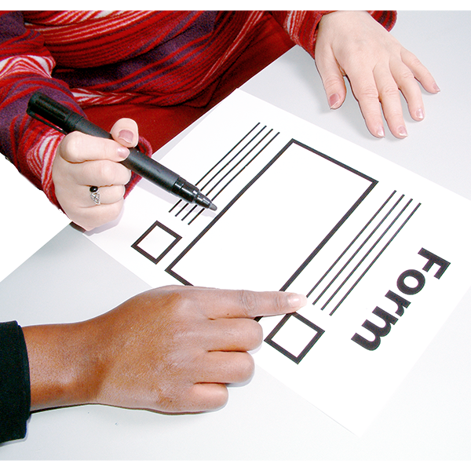
Pre Evaluation
Notes:
Slide 6 – Pre Evaluation
Note: only use this slide if you are evaluating this workshop.
Slide description:
Pre Evaluation.
(Image description: a hand holding a pen to fill out a form)
Time:
15 minutes
Why:
To improve the program for everyone.
Main Points:
Hand out any Pre Evaluation forms.
This evaluation form will help improve the program for everyone.
Please be honest and give us feedback.
It is not a test and it is not compulsory.
Extra Questions:
Does anyone need help filling in this form?
Things to watch out for:
Some people might feel uncomfortable filling this out or asking for help. Make sure someone is available to help.

Slide 7
What do you want to get out of today?
Notes:
Slide 7 – What do you want to get out of today?
Slide description:
What do you want to get out of today?
Time:
5 minutes
Why:
To find out people’s expectations for the day.
Main Points:
Ask the group what they want to get out of today.
Write all responses on a whiteboard / butcher’s paper.
Help people feel heard by repeating what they say.
Write Parking Lot at the top of another piece of butcher’s paper. If someone says something that you cannot cover, write it down here.
For more ideas, read about Expectations and the Parking Lot in the Peer Facilitators Toolbox.
Extra Questions:
If you walked away with one thing after today, what would that be?
Things to watch out for:
Some people might want something different. That’s okay! Make some time at the end of the day for people to talk about what they want. This is peer support in action!

Slide 8
Introduction to Peer Support?
Part 1: Why Peer Support?
Part 2: How to build a Peer Movement?
Part 3: What skills do I need?
Notes:
Slide 8 – Introduction to Peer Support
Slide description:
Introduction to Peer Support. Part 1: Why Peer Support? Part 2: How to build a Peer Movement? Part 3: What skills do I need?
Time:
2-5 minutes
Why:
Provide an overview of the whole training.
Main Points:
This training is made up of three different sessions.
Session 1 covers what peer support means and why it is important.
Session 2 covers what a peer movement is and how to make it happen.
Session 3 covers the most important skills for doing peer support.
Extra Questions:
Any questions? It is good to check people’s understanding early on. Make sure people feel they can ask questions.
Things to watch out for:
Don’t spend too much time on this slide, it is just an introduction. There will be time to go into detail later on.

Slide 9
How we work together
We start together on time and finish on time
We take responsibility for our own learning
We support each other to learn
We hold each other to account
We are respectful of each other
We are focused on learning
We are community – we look out for each other
…….. ?
Notes:
Slide 9 – How we work together
Slide description:
How we work together: We start together on time and finish on time; We take responsibility for our own learning; We support each other to learn; We hold each other to account; We are respectful of each other; We are focused on learning; We are community – we look out for each other …….. ?
Time:
Depends on number of people, no more than 10 minutes.
Why:
To set ground rules about what to expect from each other.
Main Points:
Before showing the slide, ask the group to tell you how they want to work together today.
Write down each person’s suggestion.
If the group runs out of ideas, go through the slide.
Talk about respect and confidentiality (see Peer Facilitators Toolbox for more information).
Check that everyone agrees with the list of ground rules before moving on.
Questions you might like to ask:
Is it ok to interrupt each other? Can we talk about everything we say here to other people? What should we do when we get stuck on something?
Things to watch out for:
Allow for conversations but keep an eye on the time.

Slide 10
Reflection
1 word that sticks from the last session
1 Thing you learned from
making a list of peers

Slide 11
How can we build a Peer Movement?
What is a Peer Movement?
3 ways of being (attributes)

Slide 12
How does change happen?
Notes:
Slide 12 – How does change happen?
Slide description:
How does change happen? (Image description: a coast line with ocean waves)
Time:
5 minutes
Why:
To explore how small actions lead to change.
Main Points:
Ask people to describe what they are thinking when they imagine ocean waves.
Sometimes change seems very, very slow.
A peer movement is a social movement.
It is about people coming together to make social change.
Social change can be very slow, just like change in nature.
Write down examples of social movements from the group.

Slide 13
Starting a movement
Notes:
Slide 13 – Video: Starting a movement
Slide description:
Starting a Movement
(Image description: black screen)
[Video description: "It looks like an outdoor music festival, there is a guy dancing. He is making quirky moves. It's just him by himself. Then a second person joins him. He acknowledges the second guy and together they dance, mostly doing their own moves. Then a third person comes and joins them and in no time it's a crowd.”]
Time:
5 minutes
Why:
Show that starting a movement can be fun.
Main Points:
Turn the sound off and ask someone to describe what is happening in the video.
This video shows us that it doesn’t have to be serious to make a movement
Someone has to start, at least one person has to join
It has to appeal for people to join, and it has to be easy to join.

Slide 14
A Social Movement
Notes:
Slide 14 – A social movement
Slide description:
A social movement. (Image description: One image of a flier with a picture of an Aboriginal child with words around it saying Right wrongs - Write Yes for Aborigines. The other image is the Aboriginal flag (red and black stripes and a yellow circle in the middle) in the shape of Australia)
Time:
5 minutes
Why:
Explore some different examples of social movements.
Main Points:
There are two examples of social movements in Australia
The fight for the right to vote for Aboriginal people
The fight for Aboriginal land rights
Watch out for:
Be careful not to spend too long on this.
Try to move on and don't get stuck in a conversation about Aboriginal land rights unless you are confident you can keep that conversation respectful and that you can bring it back to the topic.

Slide 15
Other movements
Notes:
Slide 15 – Other movements
Slide description:
Other movements. (Image description: Images of the white ribbon, the green recycling sign, the peace sign and the rainbow flag)
Time:
5 minutes
Why:
To introduce some other social movements.
Main Points:
Ask the group if they know about each image and what they mean.
White ribbon – stopping violence against women; Green logo – recycling or green movement; Peace symbol –Peace movement; Rainbow flag – LGBTQI (Lesbian Gay, Bisexual, Transgender, Queer and Intersex) movement.
Just like recycling, making change is something everyone can get involved in!
If you have time ask people to talk about what they have been involved with.
Watch out for:
Be careful not to get stuck on this slide. Remember to move the conversation along.

Slide 16
Notes:
Slide 16 – Nothing about us without us
Slide description:
(Image description: Image of people with various disability holding up a banner saying ‘Nothing about us without us’)
Time:
5 minutes
Why:
To help people feel inspired to create change through peer support.
Main Points:
Ask people what they think the slogan “Nothing about us without us” means.
Ask the group if they have been involved in anything trying to affect change for people with disability?
Watch out for:
Watch the time.

Slide 17
The Disability Rights Movement
Notes:
Slide 17 – The disability rights movement
Slide description:
The Disability Rights Movement. (Image description: this is a video)
Time:
5 minutes
Why:
To show the history of the disability movement.
Main Points:
Tell people before the video that this video has strong scenes that may be confronting for some people.
It shows how people with disability have been working together for a long time to make change.
Ideas for words to use:
“Let’s have a look at a short clip from a movie called Defiant Lives, released in mid-2017. It shows that people with disability have been getting together and working together to achieve better outcomes for themselves for a long time. Sometimes being involved in a movement is exciting and there is lots of action and protest. Sometimes it is long, slow work over many, many years.”
Things to watch out for:
This video might be confronting for some people, particularly people who have experienced abuse.
An alternative video about the peer movement is available at www.teamup.org.au/resources if you don’t want to show this.
If you do show it, ask how everyone is feeling after the video. Offer to meet with people during the break if people need to talk.

Slide 18
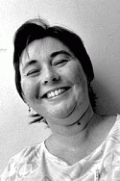
Peers leading the movement to Close Institutions in NSW
Jan Daisley
&
Kim Walker
Notes:
Slide 18 – Peers leading the movement…
Slide description:
Peers leading the movement to Close Institutions in NSW
Jan Daisley and Kim Walker. (Image description: photos of Kim and Jan)
Time:
5 minutes
Why:
People feel inspired to create change through peer support.
Main Points:
Peer leadership comes in many shapes and forms
Anyone who feels passionate about something can lead, and find other people who are equally passionate about something.
The slide shows two powerful peer leaders Jan Daisley, who only recently died, and Kim Walker.
Both were two powerful advocates for their peers in an institution. You also just saw Jan in the clip from the ‘Defiant lives’ movie.
Both woman have lived in institutions and fought hard to get out. Once out, however, they did not forget those still living inside and both became powerful advocates speaking up for the rights of all people with disability to live in the community.
It's important to honour the peer leaders who came before us and to know our history.
Things to watch out for:
Some people might say
“But, I am not like them, I couldn’t do what they did.”
Your response could be something like this
“Nobody ever feels like they can do it. It's important to know that we can do it together. We can be the change we want to see in the world. And it starts with each one of us.”

Slide 19
The Peer Movement
We (people with disability, our families and friends) are doing it for ourselves
We are the experts in our own lives
We provide supports to each other.
We value Peer Support instead of, or in addition to, traditional disability and medical supports.
Notes:
Slide 19 – The peer movement
Slide description:
The Peer Movement. We (people with disability, our families and friends) are doing it for ourselves. We are the experts in our own lives. We provide supports to each other. We value Peer Support instead of, or in addition to, traditional disability and medical supports.
Time:
10 minutes
Why:
The group defines what they think the peer movement should be about.
Main Points:
The peer movement is our movement so we can say what we are about.
Go through the points and ask if there is anything missing.
Ask people to work on this list in groups of 3 - 4
This is about brainstorming ideas not agreeing on the exact words.
Ideas for words to use:
“Here is a list of things that might be what a disability peer movement is be all about.
What do you think? Do you want to use other words?
Let's work in groups of three or four and go through this slide and then come back after five minutes.”
What do people think about the words? We don't have to agree on the words but its good to hear what everyone thinks.
Let me write it down”
Watch out for:
This is a brainstorming session. There doesn't have to be agreement on the words used. It's about bringing all the ideas in the room out into the open.

Slide 20
But what can I do?
The story of the star fish
Notes:
Slide 20 – But what can I do?
Slide description:
But what can I do? The story of the starfish. (Image description: red starfish on the bottom of the ocean)
Time:
3 minutes
Why:
To build people’s confidence that everyone can make a difference.
Main Points:
Know the story well and tell it.
The message you want to get across is everyone matters and what everyone does matters even if only for one person at a time.
Ask the group, what do you think the story means? What can we learn from this story?
Peer support happens one person at a time.
Shift the purpose back to the individual and explore what each one of us can do.
Starfish Story
Once upon a time, there was a man who used to go to the ocean every morning before starting his day. Early one morning, he was walking along the shore after a big storm had Starfish passed and found the beach full of starfish as far as the eye could see, stretching in both directions. Off in the distance, the man noticed a girl approaching. As the girl walked towards him, she paused every so often and as she came closer, the man could see that she was bending down to pick up something from the beach and throw it into the sea. The girl came closer still and the man called out: ‘Good morning! What are you doing?’ The girl comes closer and says: ‘I am throwing starfish into the ocean. They can’t return to the sea by themselves and when the sun gets hotter, they will just die. So I throw them back into the water.’ The man replied: ‘But there must be tens of thousands of starfish on this beach. I’m afraid you won’t really be able to make much of a difference.’ The girl bends down, picks up yet another starfish and throws it as far as she can into the ocean. She turns to the man, smiles and says: ‘It makes a difference to that one.’
This is a story modified from The Star Thrower, written Loren Eiseley (1907 – 1977)

Slide 21
Session 3
3 ways of being
Notes:
Slide 21 – 3 Ways of Being
Slide description:
3 ways of being
Time:
5 minutes
Why:
To introduce ways of doing peer support that promotes mutual respect and personal growth.
Main Points:
A way of being is about who we are, how we act and how we behave
It is not about our skills or knowledge or talents
How we act and behave makes a big difference in peer support
This session will introduce 3 ways of being that will help everybody grow and feel respected in peer support

Slide 22
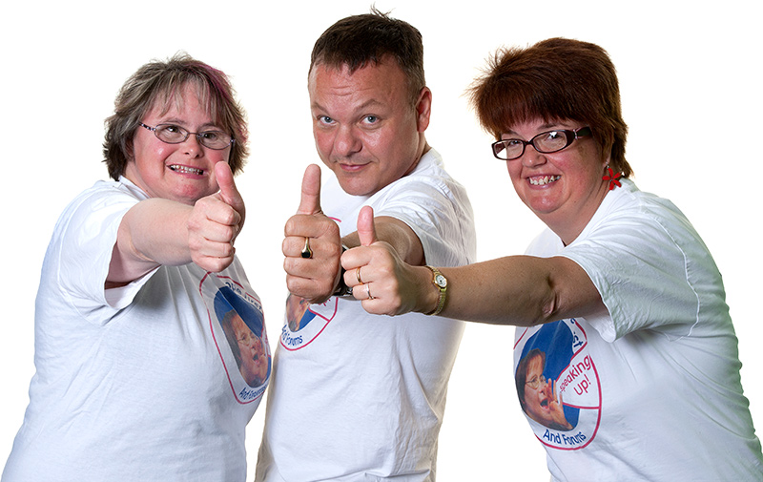
1. Being accountable
Being accountable helps build trust
Notes:
Slide 22 – 1. Being accountable
Slide description:
Being accountable. Being accountable helps build trust.
(Image description: three people giving thumbs up)
Time:
3 minutes
Why:
People are accountable to themselves and their peers in the way they do peer support.
Main Points:
For peer support to work, we have to trust one another.
Being accountable helps other people trust us.
Being accountable means that we do what we say we will do, even when no-one is watching.
Use some examples from your own life to help explain what this means.
Watch out for:
Some people might think being accountable is controlling or restrictive. But being accountable means that people care about you. Instead of nobody caring whether you do what you said you would, accountability here means, you matter, what you say and do matters, and the community around you will hold you to account.

Slide 23
Being accountable in peer support
Be your Word
Do what you say
Hold others to their word
…and if you make a mistake?
Apologise and move on.
Notes:
Slide 23 – Being accountable in peer support
Slide description:
Be your Word; Do what you say; Hold others to their word… and if you make a mistake? Apologise and move on.
Time:
5 minutes
Why:
People are accountable to themselves and their peers in the way they do peer support.
Main Points:
The slide describes some of the ways to practice being accountable in peer support
Discuss these points with the group
Being your word is about making your words mean something
Doing what you say is about building trust in yourself and having others trust you
Holding others to their word is about building trust with each other
Sometimes we make mistakes. That’s okay, but apologise.
Sometimes holding someone to account means saying something to them. This can show our trust and respect for each other.
Being accountable is how we build the peer movement
It is about respect for others and yourself!

Slide 24
2. Pay It Forward
Notes:
Slide 24 – Pay it forward
Slide description:
Pay it forward. (Image description: a heart at the bottom linking to three hearts each linking to three hearts each linking to three hearts)
Time:
3 minutes
Why:
People feel encouraged to do peer support with more people.
Main Points:
Pay it forward means giving a gift that you have received to someone new
Some people call this random acts of kindness
It means the gift keeps on giving and giving!
Ask for some examples from participants.

Slide 25
Paying it forward is…
Giving without expecting anything in return
Notes:
Slide 25 – Paying it forward is…
Slide description:
Paying it forward is - giving without expecting anything in return
Time:
2 minutes
Why:
People feel encouraged to do peer support with more people.
Main Points:
Paying it forward is about giving because you can, not because you need something in return.
Ask people about the difference between giving freely, and giving when we expect something in return.
Things to watch out for:
Some people might talk about how they are always giving and giving and not getting anything back. Ask people how they would deal with this.
Some people might also say that the things they get in return are worth less than the things they gave. Help people explore their feelings about this.

Slide 26
Paying it Forward in community
…like a Boomerang
it will come back to you!!
In a community it will
come back again and again and again!!
Notes:
Slide 26 – Paying it forward in community
Slide description:
Paying it forward in community. And like a Boomerang it will come back to you! In a community, it will come back again and again and again!
(Image description: A boomerang flying through the sky)
Time:
10 minutes
Why:
People feel encouraged to do peer support with more people.
Main Points:
Paying it forward in a community is like a boomerang it comes back.
This means that if you offer something to one person, something will come back to you.
Again see if people have examples.

Slide 27
Paying it Forward is good for you!
It lifts your self esteem
It improves your immune system
It stops negative thoughts and feelings and generates positive one
It makes you feel good about yourself
Notes:
Slide 27 – Paying it Forward is good for you
Slide description:
Paying it forward is good for you. It lifts your self-esteem, it improves your immune system, it stops negative thoughts and feelings and generates positive ones, it makes you feel good about yourself.
Time:
2 minutes
Why:
People feel encouraged to do peer support with more people.
Main Points:
Read out the slide and ask the group what they think.
Even if we feel we are paying it forward and nothing is coming back, research suggests it's good for us.
Watch out for:
Some people might still be unsure about this. If they are the same people as before and even those benefits can't convince them, maybe it's time to move along.
Remember you are a facilitator of a program; you don't have to convince people of anything.

Slide 28
3. Be humble - make a difference
“being humble means recognising that we are not on earth to see how important we can become, but to see how much of a difference we can make in the lives of others”
(Gordon Hinckley)
Notes:
Slide 28 – 3. Be humble – make a difference
Slide description:
3. Be humble – make a difference. “being humble means recognising that we are not on earth to see how important we can become, but to see how much of a difference we can make in the lives of others” (Gordon Hinckley)
Time:
5 minutes
Why:
People are humble in the way that they do peer support.
Main Points:
Wanting to make a difference or a contribution to someone else is a great attribute.
It’s not about us but about the other people.
Ask the group why they think being humble is an important way of being in peer support.
Write down people’s answers.

Slide 29
Humble Head
Humble | Not Humble
Notes:
Slide 29 – Humble Head
Slide description:
Humble Head. (Image description: two columns, with the headings humble and not humble)
Time:
5 minutes
Why:
To unpack the meaning of being humble.
Main Points:
Ask someone to draw two columns on the board and write “humble” and “not humble” at the top of each column
Ask people to call out names of people they know and which column they belong
Talk about why they are either humble or not humble.

Slide 30
Be humble – remember that:
You are no more an expert
than the person next to you
What is right for you might not be right for them
Notes:
Slide 30 – Be humble – remember that
Slide description:
Be Humble – remember that: You are no more an expert than the person next to you; what is right for you might not be right for them
Time:
5 minutes
Why:
People see that being humble is an important in peer support.
Main Points:
Remind people that everyone is the expert in their life.
What’s right for one person might not be right for another person.

Slide 31
Video – Doing Peer Support
Notes:
Slide 31 – Doing peer support
Slide description:
Doing peer support (Image description: Black rectangular, this is a video)
Time:
The video goes for 6 minutes.
Why:
To hear from other peers about what makes peer support work.
Main Points:
The video talks about some important things that make peer support work
openness, curiosity, empathy
paying it forward
inclusive language
being accountable
If you have time, ask people what they thought about the video.

Slide 32
Next session
Skills for peer support:
Listening
Asking questions
Empathy
Notes:
Slide 32 – Next session
Slide Description:
Next session. Skills for peer support. Listening, Asking Questions, Empathy
Time:
2 minutes
Why:
Get people thinking about next session.
Main Points:
Introduce the topics for the next session, Skills for peer support
We will practice listening, asking questions and empathy in ways that help peer support.
Get people excited about the next session

Slide 33
For next week
Practice Peer support
Think about who your Peers are (make a list)
Have a conversation with a Peer
Ask for or offer some support to a Peer
Come back next week to share your experiences with your Peers here!
Notes:
Slide 33 – For next week
Slide Description:
For next week. Practise Peer support, Think about who your Peers are (make a list), Have a conversation with a Peer, Ask for or offer some support to a Peer, Come back next week to share your experiences with your Peers here!
Time:
5 minutes
Why:
People start to practice what they have learned about peer support in their lives.
Main Points:
To get good at something everyone needs to practice.
Ask the group to do at least two peer tasks before next week. The slide gives some examples.
Make a list of the peers in your life.
Find a peer to talk to
Ask for or offer some peer support.
If you think you don’t have a peer, make sure you connect with someone from here before you leave. Grab a phone number and/or make a time for a coffee.
Come back next week and share with the group.

Slide 34
Post Evaluation
Notes:
Slide 34 – Post Evaluation
Slide description:
Post evaluation
Time:
5 minutes
Why:
To get feedback on how to improve the program.
Main Points:
Hand out the Post Evaluation form.
This evaluation form asks people what they have learned from the session.
This is not a test.
It will help to improve the program for everyone.
Please be honest and give us feedback.

Slide 35
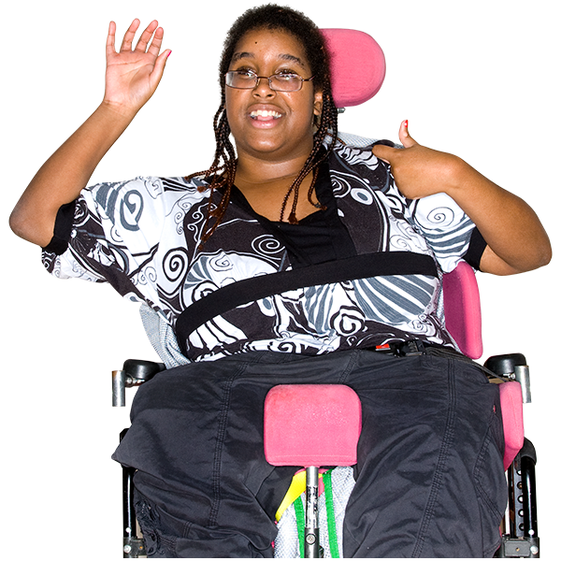
Check out
Notes:
Slide 11 – Check-out
Slide description:
Check out. (Image description: A woman using a wheelchair is waving and has her thumbs up)
Time:
5 minutes
Why:
To find out how people are feeling and their next steps.
Main Points:
A check-out helps find out how people are feeling at the end of the workshop.
It is also a very powerful way of building accountability and community.
Ask everyone to write down one word about how they are feeling at the end of the training and one next action from today’s training that they are going to take in peer support
Ask everyone to share their one word and action with the group
Make sure someone is available to write down people’s answers

